Slide 1
Computer Graphics 11th Recitation “OpenGL: Blending and Textures”
Anna Shtengel
Based on slides by Michael Litvin
25.5.2015

Slide 2
Today!
Model View Controller
Light code project example (go through code)
Blending
Textures
Textures and transparency code project example

Slide 3
Model-View-Controller
User
Controller
Use (input)
See (output)
Change
Manipulate
Update
View
(Display)
Model
(Data)
Update

Slide 4
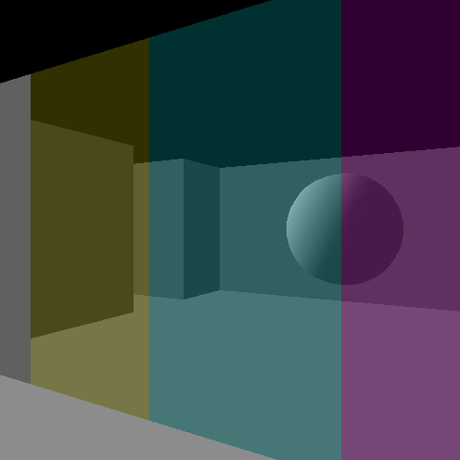
Blending
So what’s that alpha all about?

Slide 5
How Do We Use Blending?
The first thing you need to do is ENABLE it:
glEnable(GL_BLEND);
Blending is done per-pixel.
The pixel that exists in the color buffer is called destination and the one we are trying to blend is called source.

Slide 6
Blending
Blending is computed by the following equation:
S_{factor}* S_{color} + D_{factor} * D_{color} = Pixel_{color}
Set factors using:
void glBlendFunc(sfactor, dfactor);
S
D
Notes:
צירוף לינארי של הקיים והחדש

Slide 7
Blending
Different constants are defined for the source and destination factors in order to achieve different blending effects. Most common combination is:
glBlendFunc(GL_SRC_ALPHA, GL_ONE_MINUS_SRC_ALPHA);
S_{alpha}* S_{color} + (1- S_{alpha})* D_{color} = Pixel_{color}
Default combination is:
glBlendFunc(GL_ONE, GL_ZERO);
Notes:
מה קורה כשאלפה = 1 או 0?

Slide 8
The Alpha Channel
a = 1.0
a = 0.6
a = 0.2
glColor4f(float r, float g, float b, float a);
glMaterialfv(GL_FRONT, GL_DIFFUSE,
new float[] {0.75f,0.75f,0.75f,0.5f});

Slide 9
Setting Alpha
When lighting is off, alpha is the fourth parameter of glColor
With lighting on, alpha is the fourth coordinate of diffuse color (only!)
Textures, Images – Fourth coordinate of current color (material when lighting on, color when lighting off)
glColor4f(float r, float g, float b, float a);
glMaterialfv(GL_FRONT, GL_DIFFUSE,
new float[] {0.75f,0.75f,0.75f,0.5f});

Slide 10
Order Matters
Back-to-Front
Arbitrary Order
Notes:
מה עם MESHים שקופים? לרנדר פוליגונים שלהם לפי הסדר?
Right case: the blue opaque is drawn beneath the transparent because of the depth test!

Slide 11
Partial Solution
Render all opaque (אָטוּם) polygons first.
Make the depth buffer read only*
Render transparent polygons
Enable depth buffer writing
Opaque First
*glDepthMask(false)

Slide 12
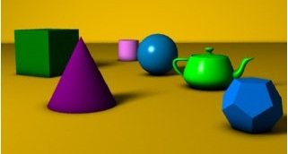
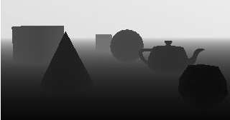

Recall: Depth-buffer masking
By default every write to color buffer writes depth in Depth buffer
Disable writing with
glDepthMask(false)
Enable writing with
glDepthMask(true)
Note: also affects glClear()!
If backfaces aren’t completely transparent disable cull faces with
glDisable(GL_CULL_FACE)

Slide 13


Bad News
This method has problems
Rendering order affects overlaying transparent polygons of different colors
Suggested solution
Sorting transparent polygons

Slide 14
Corrected Solution
Render all opaque (אָטוּם) polygons first.
Make the depth buffer read only*
Sort transparent polygons
Render transparent polygons back to front
Enable depth buffer writing
Opaque First
*glDepthMask(false)

Slide 15

More Bad News
Very costly☹
Sorting polygons is also a problem sometimes
Distance from center of polygon is usually good enough

Slide 16
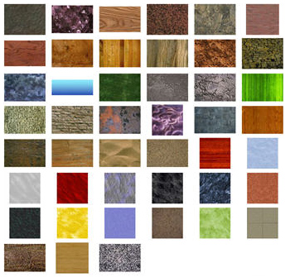
Textures
Look, it’s wooden!

Slide 17
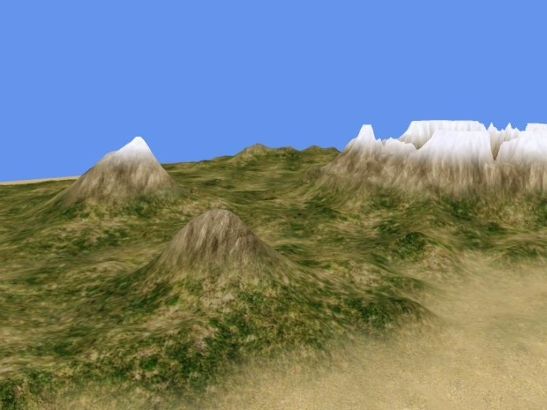
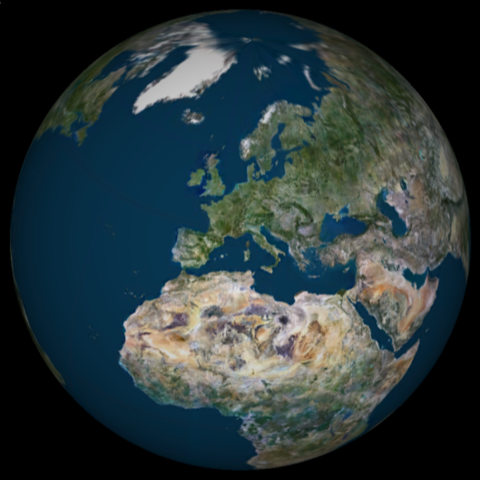
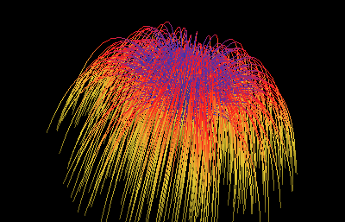
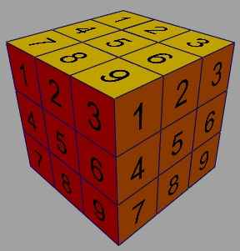
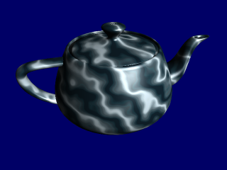
OpenGL Supported Textures
1D Texture
2D Texture
3D Texture

Slide 18
Textures usage in OpenGL
Register and load a texture object
At initialization
Turn on texturing
Enable texturing
Bind texture
Draw geometry with texture mapping
Set texture coordinates per vertex

Slide 19
Texture Loading
Load image from file and store on video card
Stored in raw format
OpenGL functions
glGenTextures, glTexImage2D, glDeleteTextures
JOGL wrapper
File f = new File(“floor.jpg");
Texture tex;
tex = TextureIO.newTexture(f, true);
This is usually done in init()

Slide 20
Enable Texture Rendering
glEnable(GL_TEXTURE_2D)
OpenGL will Rasterize with currently bound 2D texture
GL_TEXTURE_1D, GL_TEXTURE_3D
Select current texture:
OpenGL: glBindTexture(…)
JOGL: Texture.bind()
This is usually done in display(), right before rendering the shape.
After you’re done, don’t forget to call glDisable(GL_TEXTURE_2D)

Slide 21
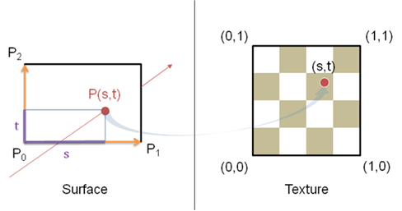
Texture Parameterization
Specify coordinate points per vertex
Surface parameterization
void glTexCoord*(TYPEcoords);
You can specify 1,2,3 or 4 texture coordinates using this function
Usually we use 2
Parameterization:

Slide 22
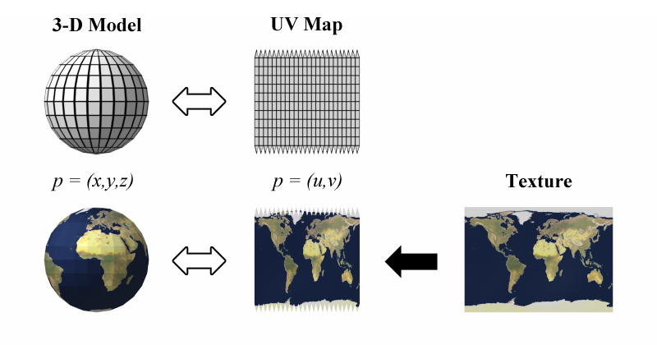
Texture Coordinates On A Sphere

Slide 23
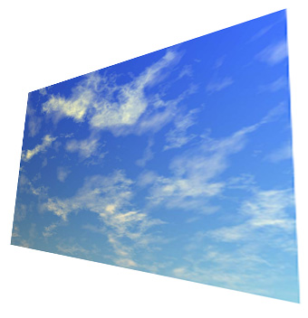
Example
tex.bind()
glBegin(GL_QUADS)
glTexCoord2f(0,0)
glVertex3f(1,0,0)
glTexCoord2f(1,0)
glVertex3f(2,0,0)
glTexCoord2f(1,1)
glVertex3f(2,2,1)
glTexCoord2f(0,1)
glVertex3f(1,2,1)
glEnd()
(1,1)
(0,1)
(0,0)
(1,0)

Slide 24
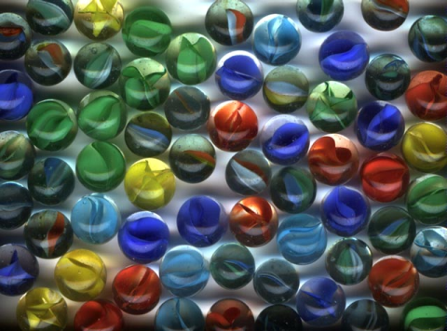
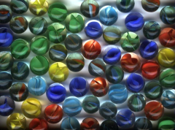


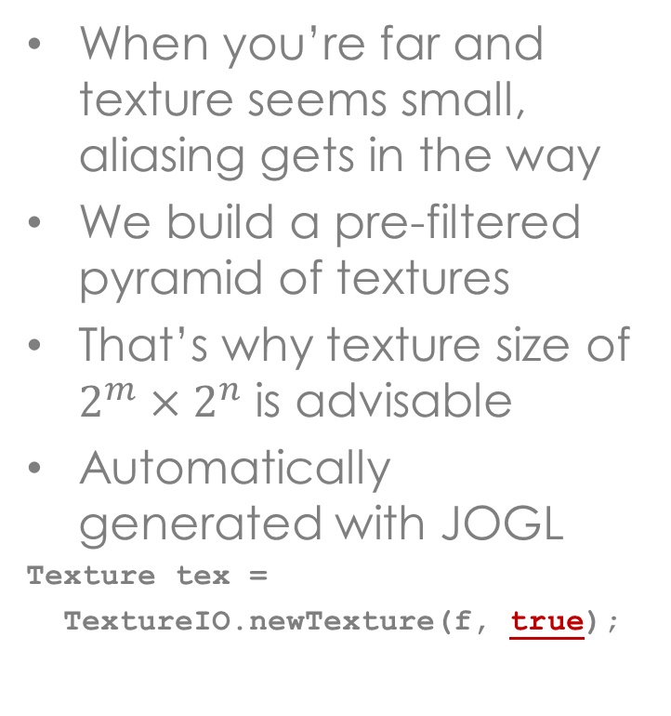
Mip Maps
When you’re far and texture seems small, aliasing gets in the way
We build a pre-filtered pyramid of textures
That’s why texture size of $2^{m}×2^{n}$ is advisable
Automatically generated with JOGL
Texture tex =
TextureIO.newTexture(f, true);

Slide 25
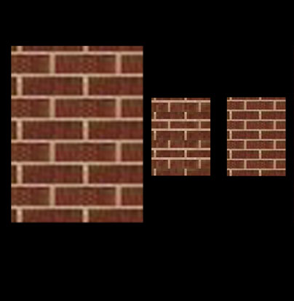
Minification Issues
without mipmap
with mipmap

Slide 26
Texture Filtering
1
Minification
Magnification
Pixels
Texels
Pixels
Nature of problem:
Mismatch between texels and pixels

Slide 27
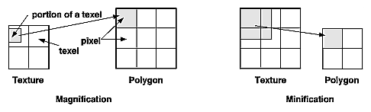
Mip Maps
You can control how filtering is done
void glTexParameter*(target, pname, *param);
Examples:
glTexParameteri(GL_TEXTURE_2D, GL_TEXTURE_MAG_FILTER, GL_NEAREST)
glTexParameteri(GL_TEXTURE_2D, GL_TEXTURE_MIN_FILTER, GL_LINEAR)
GL_LINEAR_MIPMAP_LINEAR produces best quality for minification, and GL_LINEAR for magnification.
Affects only bound (active) texture.

Slide 28
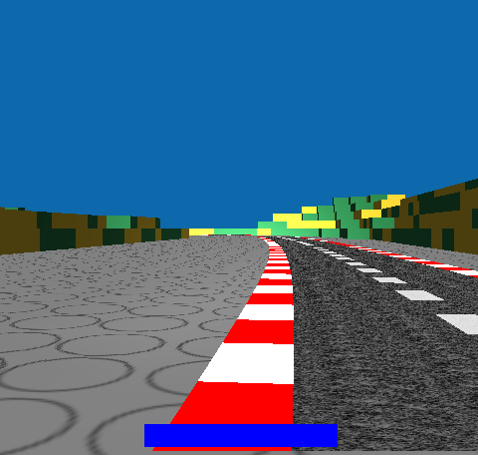

Minification still sometimes an issue…
GL_NEAREST
GL_LINEAR_MIPMAP_LINEAR

Slide 29
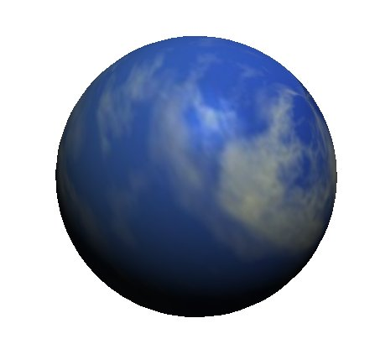
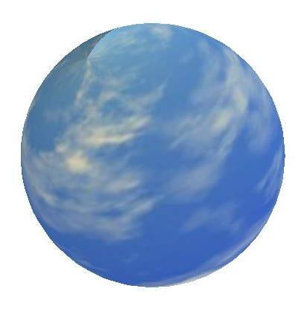
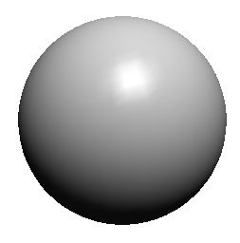
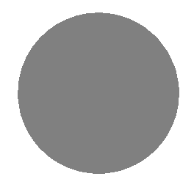
Texture Blending
GL_MODULATE
GL_REPLACE

Slide 30
Texture Blending
void glTexEnv*(target, pname, *param);
Controls whether texture replaces or blends with shading color
Examples:
glTexEnvf(GL_TEXTURE_ENV, GL_TEXTURE_ENV_MODE, GL_MODULATE)
glTexEnvf(GL_TEXTURE_ENV, GL_TEXTURE_ENV_MODE, GL_REPLACE)

Slide 31
Texture Coordinate Offset
What if texture coordinates <0 or >1?
You can decide between wrap modes using:
void glTexParameter*(target, pname, *param);
Example:
gl.glTexParameterf(GL.GL_TEXTURE_2D, GL.GL_TEXTURE_WRAP_T, GL.GL_REPEAT);
gl.glTexParameterf(GL.GL_TEXTURE_2D, GL.GL_TEXTURE_WRAP_S, GL.GL_CLAMP);
T:Repeat
S: Clamp

Slide 32
Typical Texture Code
File f = new File(“image.jpg");
Texture tex;
tex = TextureIO.newTexture(f, true);
Init code
tex.bind();
gl.glTexParameterf(GL.GL_TEXTURE_2D, GL.GL_TEXTURE_WRAP_T, GL.GL_CLAMP);
gl.glTexEnvf(GL.GL_TEXTURE_ENV, GL.GL_TEXTURE_ENV_MODE, GL.GL_MODULATE);
gl.glEnable(GL.GL_TEXTURE_2D);
gl.glBegin(GL_QUADS)
gl.glTexCoord2f(0,0); gl.glVertex3f(1,2,0);
gl.glTexCoord2f(1,0); gl.glVertex3f(2,2,0);
gl.glTexCoord2f(0,1); gl.glVertex3f(1,0,1);
gl.glTexCoord2f(1,1); gl.glVertex3f(1,1,1);
gl.glEnd()
gl.glDisable(GL.GL_TEXTURE_2D);
Display code

Slide 33
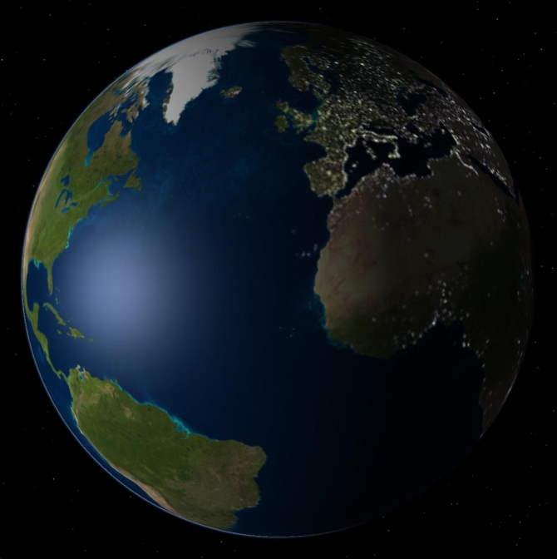
Texture On GLU Quadrics
Very simple, just call:
glu.gluQuadricTexture(quad, true);
GLU will map the texture on any quadric.
Caveat: sometimes texture is flipped
You can either flip the texture file or call glScaled(-1,1,1);

Slide 34

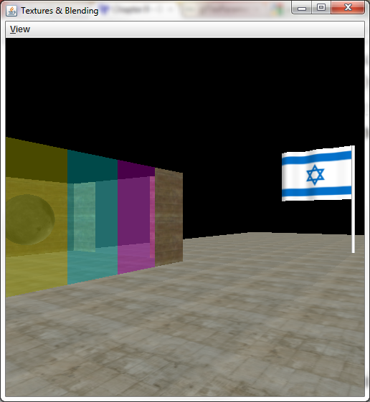


Code Example: Textures & Blending

Slide 35
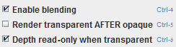
Blending Interesting Phenomenon
The balls in the scene are inside rooms with transparent walls, the camera is outside
Look at the following configuration:
Enable blending
Don’t render transparent after opaque =>the balls are rendered after the transparent walls in the code
See how “depth read only when transparent” affects!

Slide 36
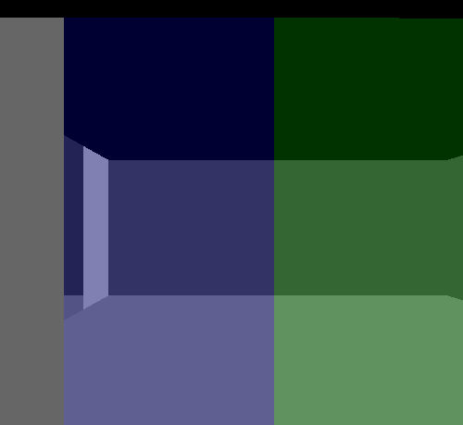
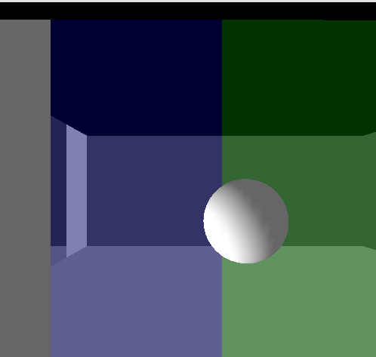
Depth Read Only When Transparent Property
The balls are rendered after the transparent walls in the code
depth read only when transparent unchecked:
The walls depth is stored in the depth buffer
The balls fail the depth test against the walls
The balls are not rendered!
depth read only when transparent checked
The depth of the walls isn’t stored in the depth buffer
The balls appear before the walls!

